Slide 1
QlikSense Training
I&D India – QlikSense CoE

Slide 2
Session 02

Slide 3
Session Agenda
Creating a Simple App
Step by Step Process to Create an App
Data Load Basics
Introduction to the Data Model Viewer
Introduction to the Data Manager
Introduction to the Data Load Editor
Reload Data for Analysis
Considerations when Loading Data from Excel
Using the Qlik DataMarket Package

Slide 4
Step by Step Process to Create an App
The app is at the core of Qlik Sense. An app is loaded with data, and the visualizations the app contains allow you and your colleagues to explore the data.
The first thing you need to do when building an app is to create an empty placeholder for it. You create the app placeholder from the hub.
Do the following:
Click Create new app in the hub.
Give your app a name.
Click Create. The app is created.
Click Open app.
The app opens in the app overview.
The next step is to load data into the new app

Slide 5
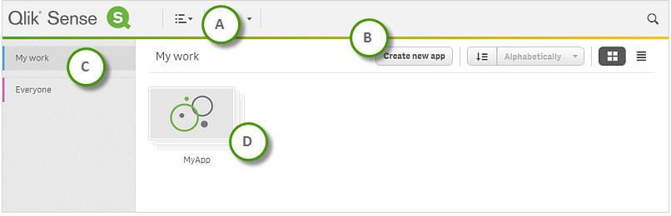
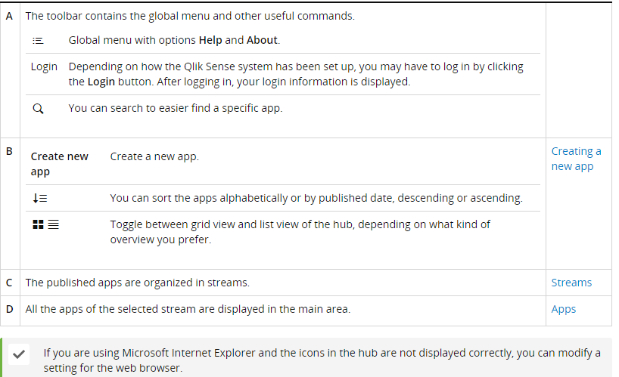
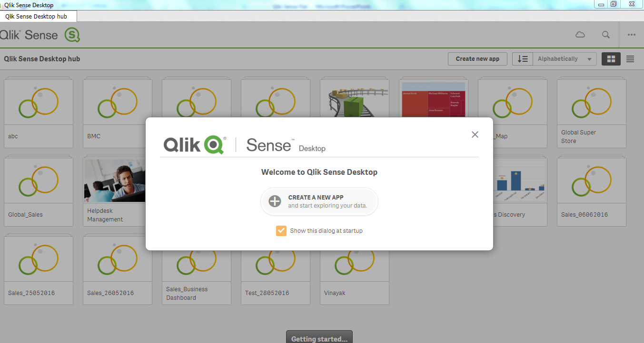
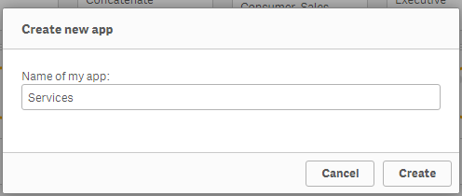
Simple App Creation

Slide 6
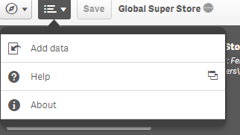
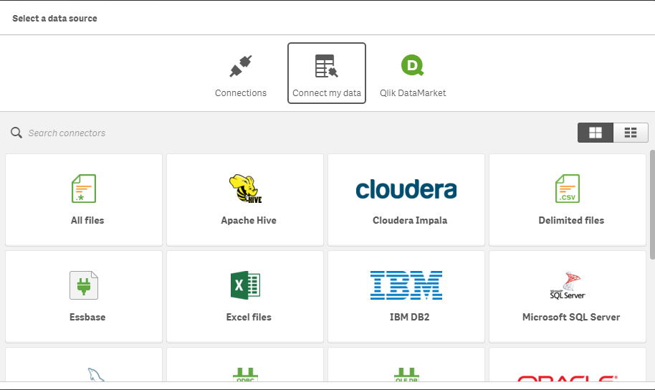
Data Load Basic
Selecting data fields from files and databases
Selecting data from a Microsoft Excel spreadsheet ->
When you add data from a Microsoft Excel spreadsheet, the file can contain several sheets. Each sheet is loaded as a separate table. An exception is if the sheet has the same field/column structure as another sheet or loaded table, in which case the tables are concatenated.
Click on Add data Select the data Connection

Slide 7
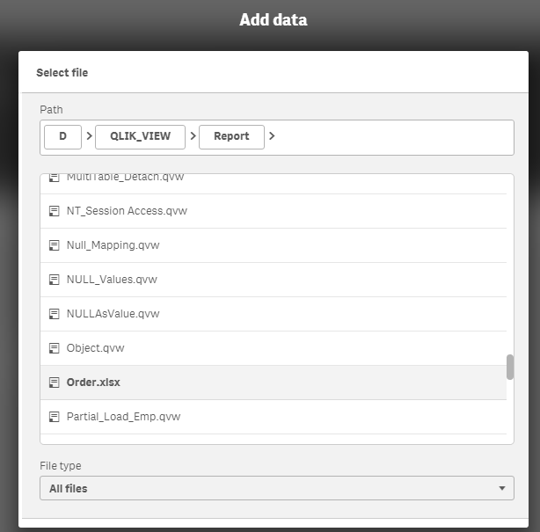
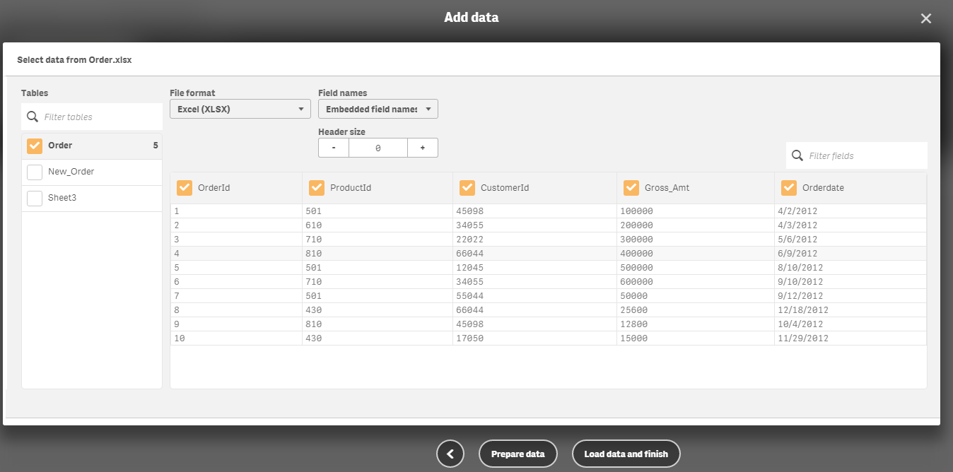
Data Load Basic (Contd…)
Select data File Data display in data viewer

Slide 8
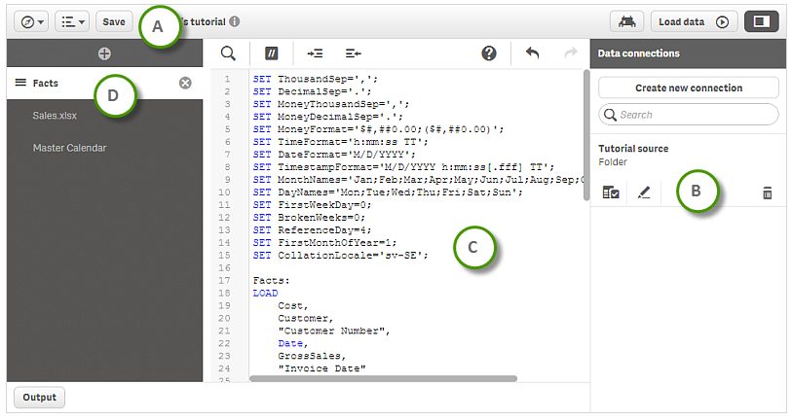
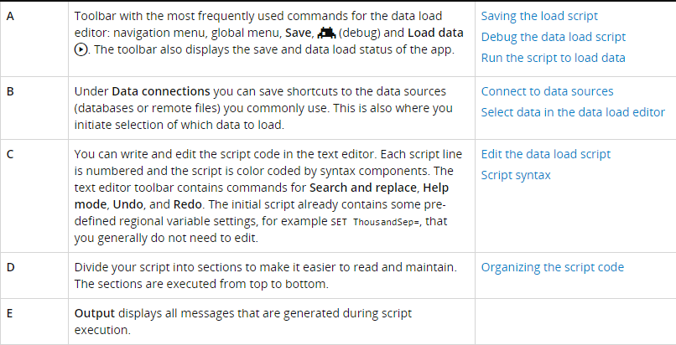
Data Load Basic (Contd…)
Using the data load editor
This section describes how to use the data load editor to create or edit a data load script that can be used to load your data model into the app.
The data load script connects an app to a data source and loads data from the data source into the app. When you have loaded the data it is available to the app for analysis. When you want to create, edit and run a data load script you use the data load editor.
A script can be typed manually, or generated automatically. Complex script statements must, at least partially, be entered manually.

Slide 9
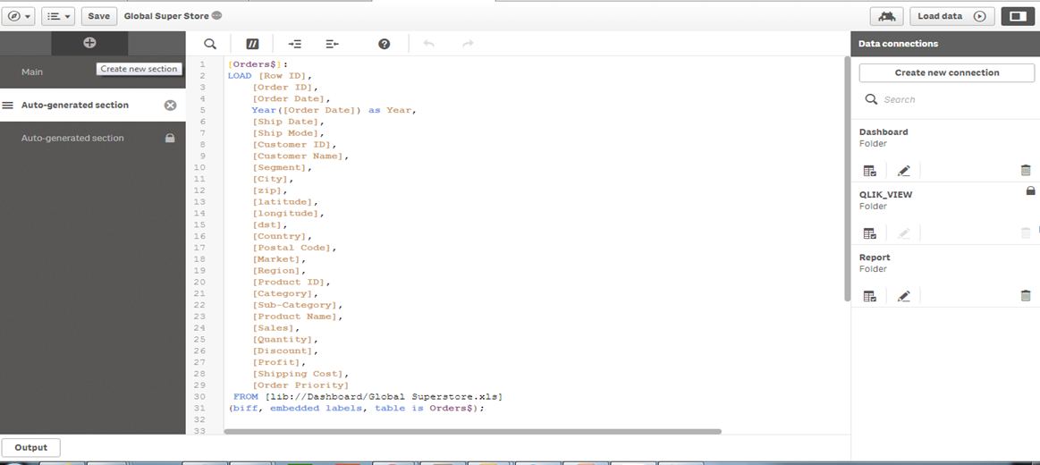
Data Load Editor
This section describes how to use the data load editor to create or edit a data load script that can be used to load your data model into the app.

Slide 10
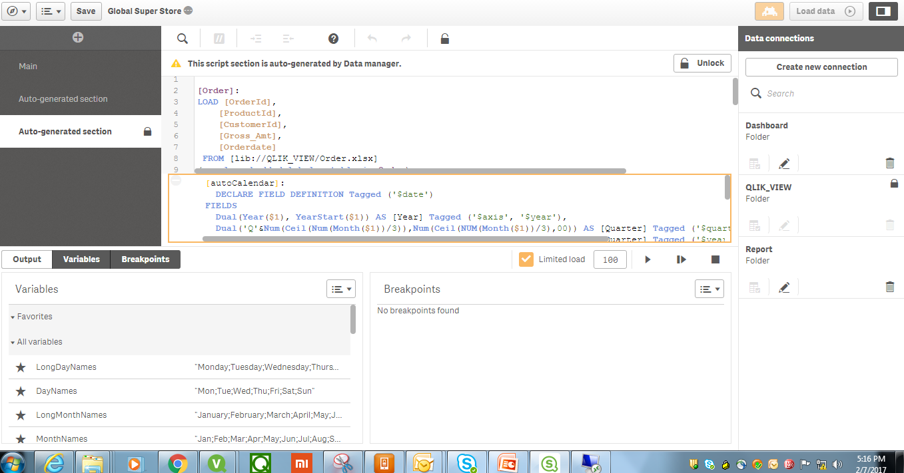
Data Load Editor (Contd..)
Debug the data load script
You can use the debugging utilities in the data load editor to step through the execution of your script by using breakpoints, which will enable you to inspect variable values and output from the script execution. You can select if you want to view any or all of Output, Variables and Breakpoints.
To show the debug panel, do the following:
Click in the data load editor toolbar.
The debug panel is opened at the bottom of the data load editor.

Slide 11
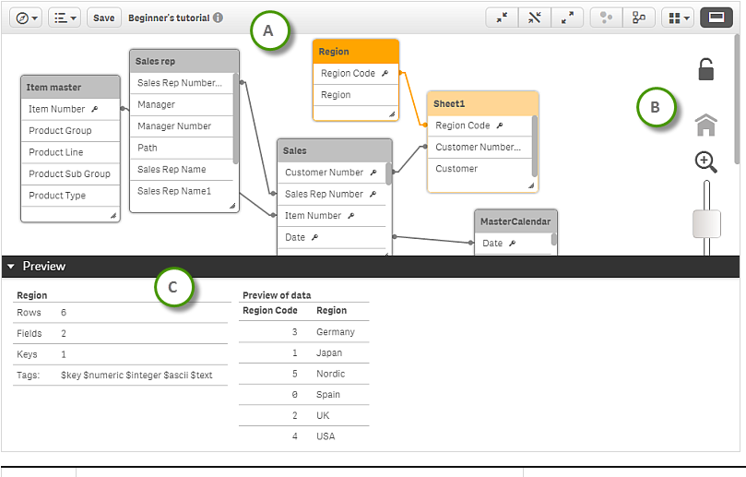
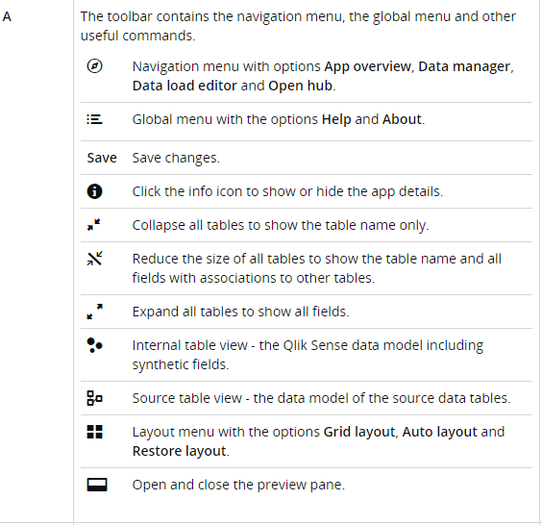
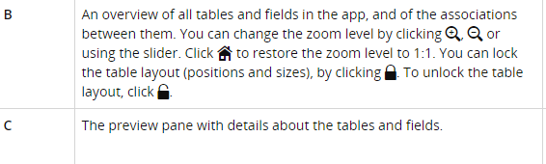
Data Model Viewer
Data model viewer
The data model viewer provides you with an overview of the data structure of an app. You can view detailed metadata about the tables and fields as well as create dimensions and measures from the data fields.

Slide 12
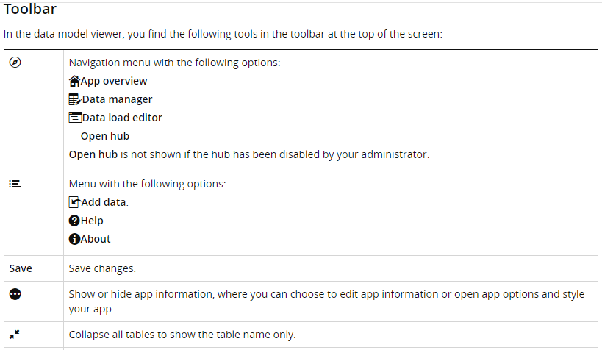
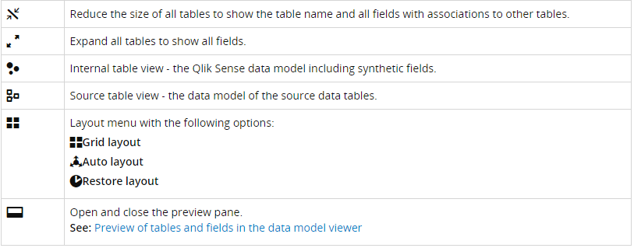
Data Model Viewer (Contd..)
Data model viewer
In the data model viewer, each data table is represented by a box, with the table name as title and with all fields in the table listed. Table associations are shown with lines, with a dotted line indicating a circular reference. When you select a table or a field, the highlighting of associations instantly gives you a picture of how fields and tables are related.
You can change the zoom level by clicking or using the slider. Click to restore the zoom level

Slide 13
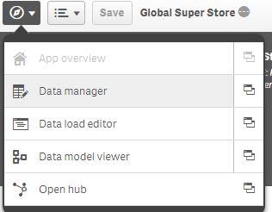
Data Manager
Managing data in the app with the Data manager
The Data manager is where you add and manage data from your own data sources, or from Qlik DataMarket, so that you can use it in your app.

Slide 14
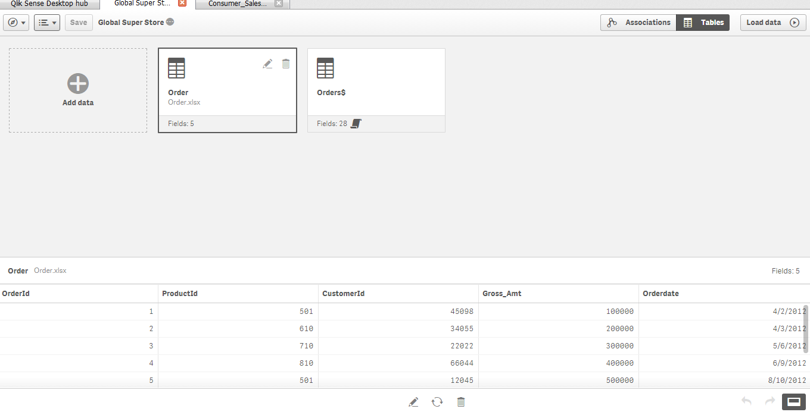
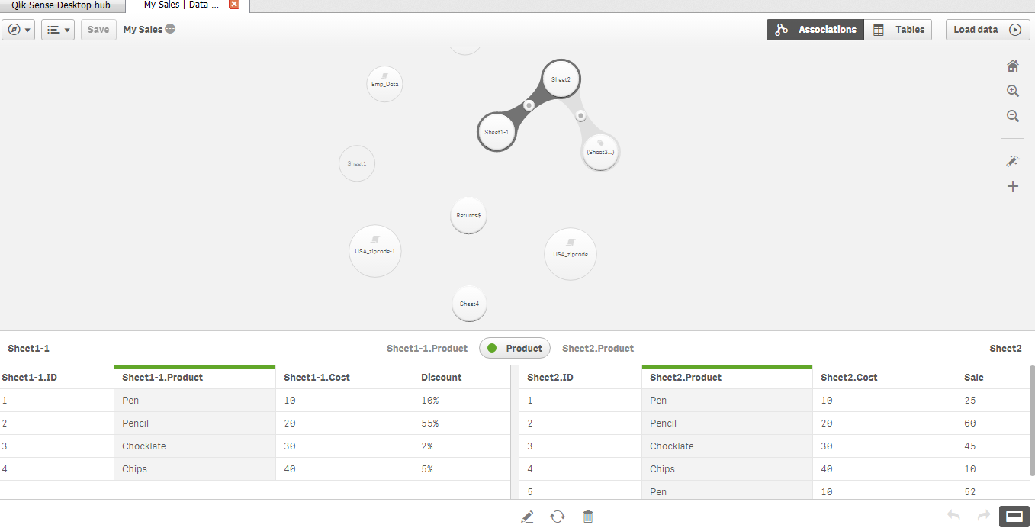
Data Manager (Contd..)
There are two views in data manager:
Tables
You get an overview of all data tables
in the app, whether you added them
using Add data, or loaded them with
the data load script. Each table is displayed
with the table name, the number of
data fields, and the name of the data source.
Associations
You can create and edit association
between tables.

Slide 15
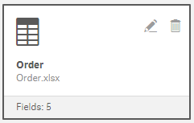
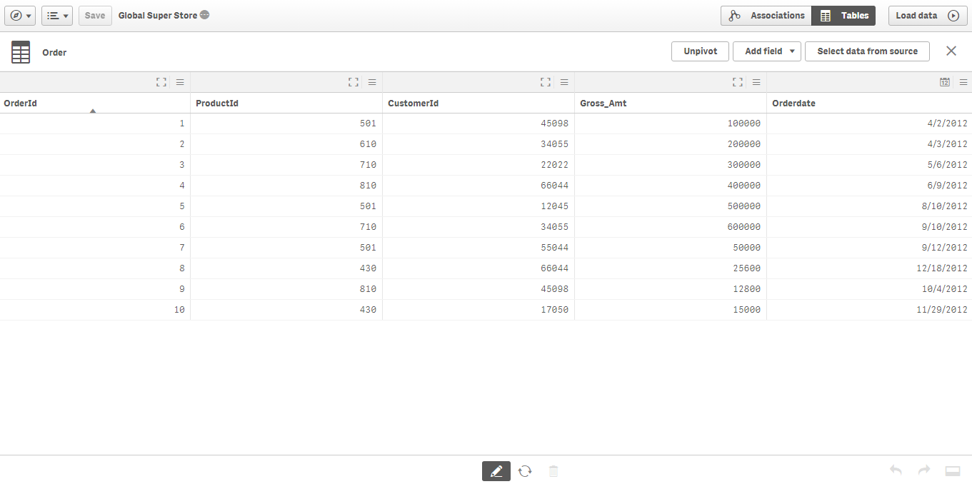
Data Manager (Contd..)
Managing data in the app with the Data manager
Edit upload data in Data manager
Change Field Types and Display Format, Upload Table from data Source
Add Calculated Fields

Slide 16
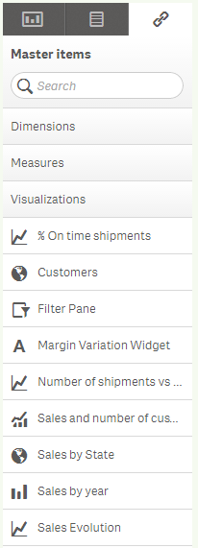
Master Items
What is Master Item?
Create and save reusable dimensions,
measures and visualizations as master items.

Slide 17
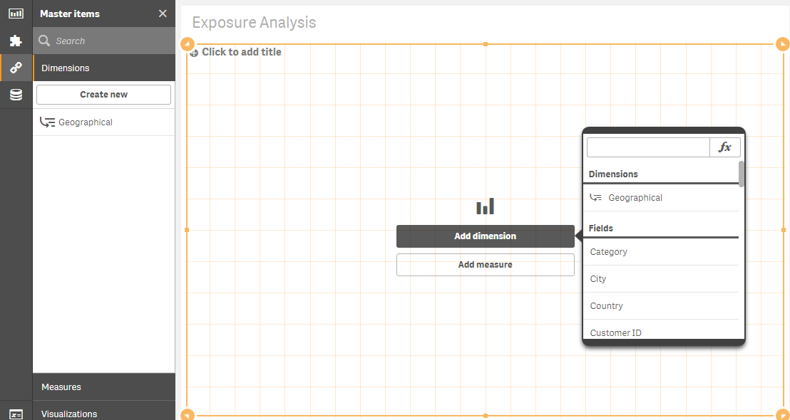
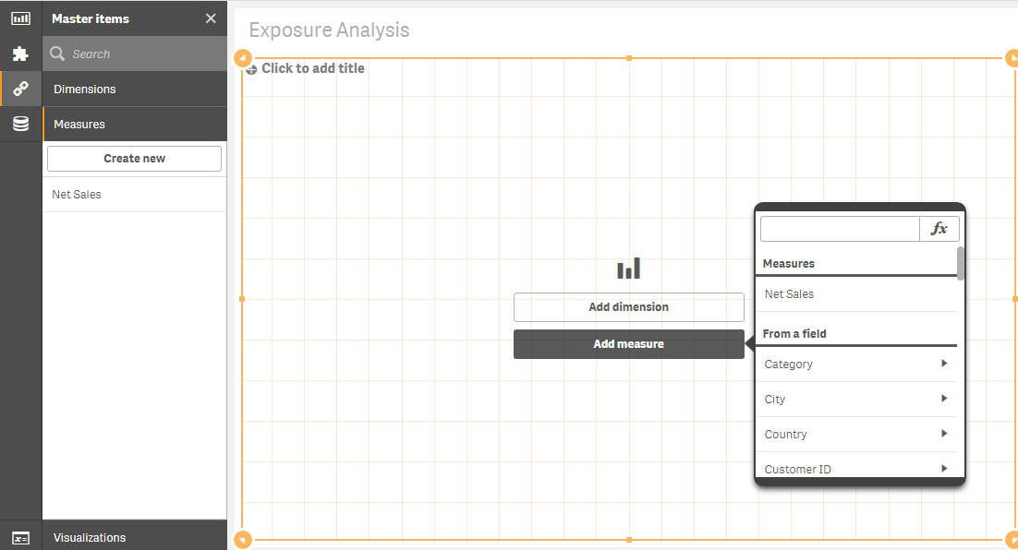
Master Key with Dimension and Measure
Why and Where it is needed?
Master Items can be used to create visualizations and once the app is published, the Master Items are available in the Library panel.
When creating apps, it is common to use the same dimensions and/or measure in more than one chart – that is why Master Items are so useful.

Slide 18
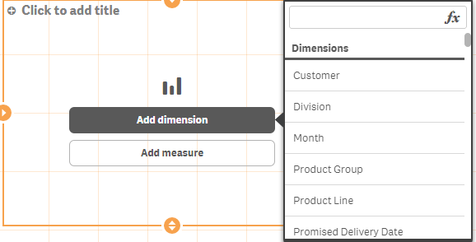
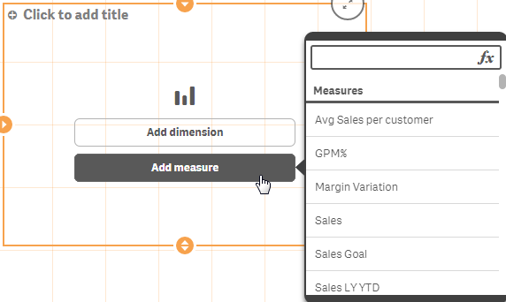
Create Master Dimension and Measure
How it is created?
There are a few ways you can create
a Master Item as shown below
Create master dimensions :
There are three ways you can create a dimension.
From the Fields section in the Asset panel
From the Master Items section in the Asset panel
From the Data Model Viewer
Create master measures :
There are three ways you can create a Measure.
From the Fields section in the Asset panel
From the Master Items section in the Asset panel
From the Data Model Viewer
A measure is a combination of an expression
and descriptive data, such as name, description and
tags. You can add the expression for the measure in
different ways.

Slide 19
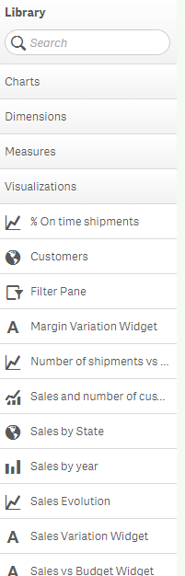
Create Master Visualization
Creating a master visualization :
You can create a master visualization to be
able to reuse it. Users of a published app
will have access to the master visualizations
in their library, but will not be able to modify them.

Slide 20
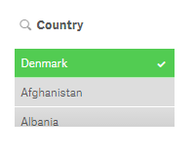
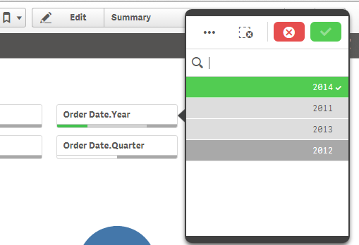
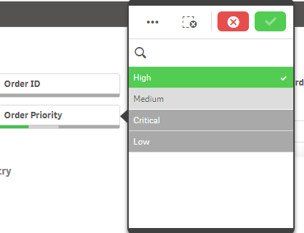
Bookmarks
What is BookMarks?
When you are analyzing data, you might find something interesting that you want to return to, or share with others. Using bookmarks is a way to easily keep track of a certain selection state on a certain sheet.
Creating a bookmark
Do the following:
Make the selections on the sheet that you want to save as a bookmark
Selected a Data
from different Dimension

Slide 21
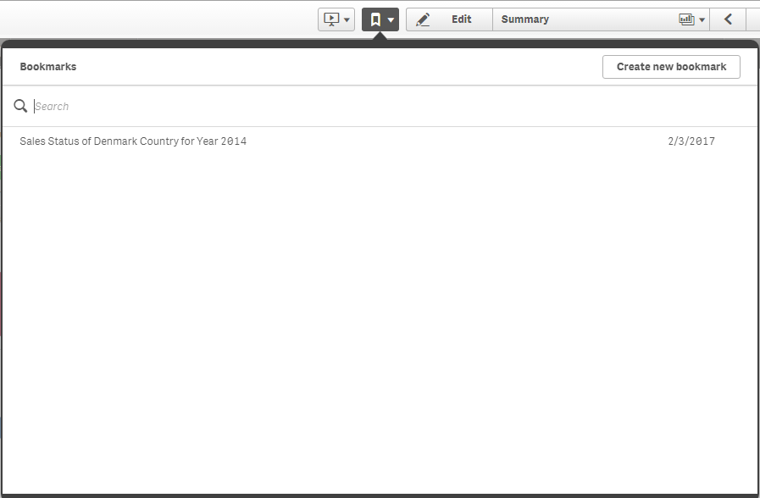
Create and Apply Bookmarks
Why and Where it is needed?
You can add bookmarks to save your selections and a particular location. The bookmarks can later on be opened to restore the selections to a former state. When you use the bookmark, you can either just apply its selections or apply selections and go to the sheet you were exploring when you created the bookmark. All bookmark tools are reached with > in the toolbar
Click on in the toolbar

Slide 22
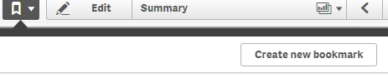
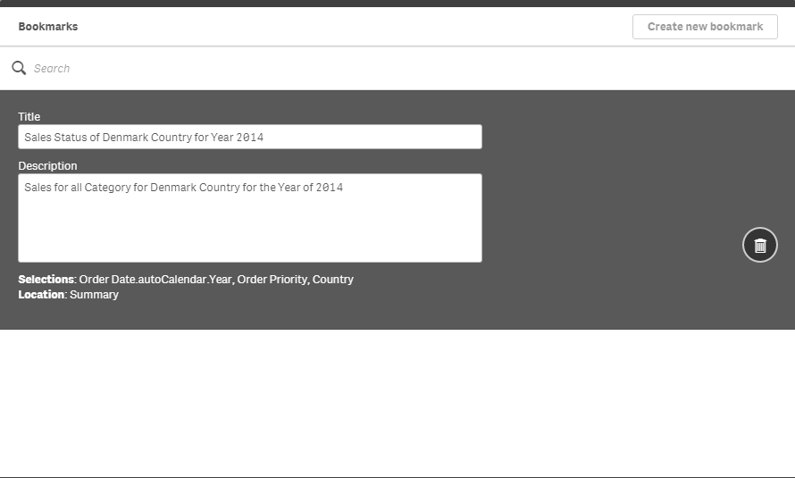
Create and Apply Bookmarks (Contd..)
Click Create new bookmark.
The name of the sheet and a summary
of the selections are used as
the title of the bookmark.
If you want another name
for the bookmark, change it under Title.
Enter a description of the bookmark under
Description if you want to.
The bookmark is automatically saved.

Slide 23
Build and Play Stories
Qlik Sense introduces data storytelling as a new way of sharing our data discovery insights with other people.
The purpose of data storytelling is to build a narrative around the story and to emphasize elements of it
Data storytelling in Qlik Sense lets you combine reporting, presentation and exploratory analysis techniques to create and share a collaborative experience
Build Story
Do the following:
Create Story
Add Slides and Snapshots
Arrange Slides
Copy and Resizes Item

Slide 24
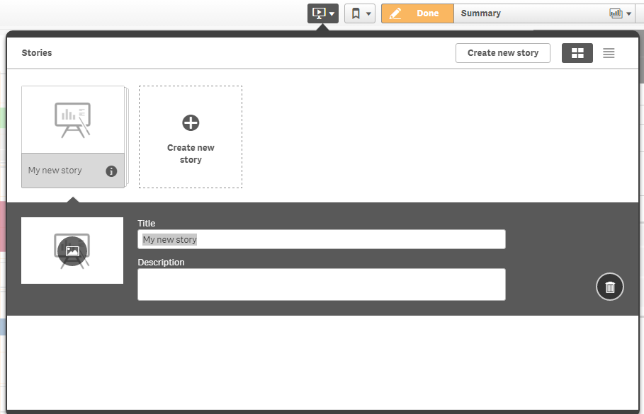
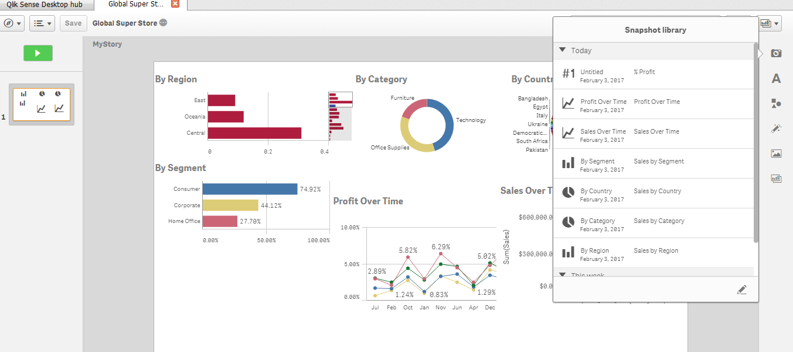
Build and Play Stories (Contd..)
Create Story Add Slides and Snapshots
.

Slide 25
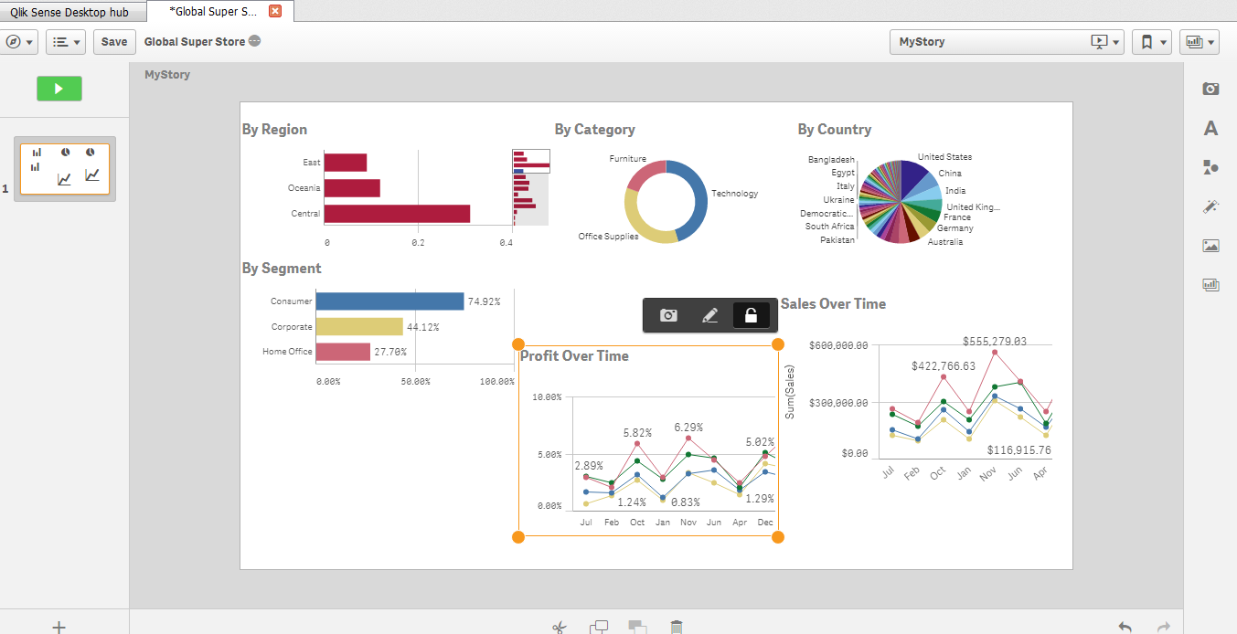
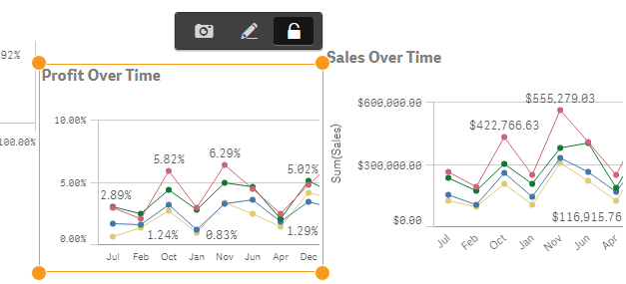
Build and Play Stories (Contd..)
Arrange Slides Copy and Resizes Item
.

Slide 26
Loading Data from Excel
Selecting data from a Microsoft Excel spreadsheet ->
When you add data from a Microsoft Excel spreadsheet, the file can contain several sheets. Each sheet is loaded as a separate table. An exception is if the sheet has the same field/column structure as another sheet or loaded table, in which case the tables are concatenated.
Click on Add data Select the data Connection (Qlik DataMarket Package )

Slide 27
Loading Data from Excel (Contd..)
Select data File Data display in data viewer

Slide 28
Loading Data from Excel (Contd..)
We are able to see Script for loaded data in Data Load editor. This section describes how to use the data load editor to create or edit a data load script that can be used to load your data model into the app.
The data load script connects an app to a data source and loads data from the data source into the app. When you have loaded the data it is available to the app for analysis. When you want to create, edit and run a data load script you use the data load editor.
A script can be typed manually, or generated automatically. Complex script statements must, at least partially, be entered manually.

Slide 29
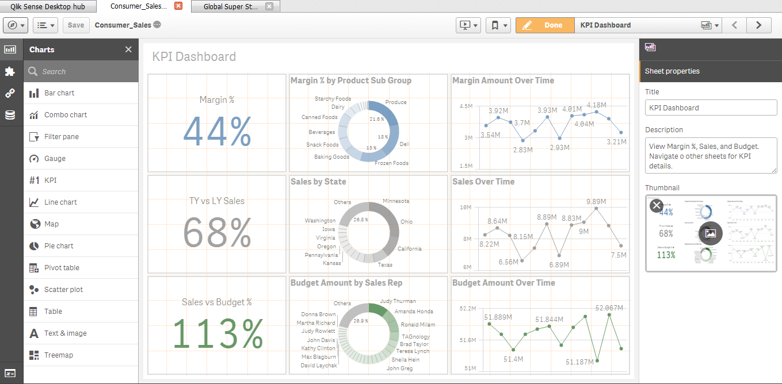
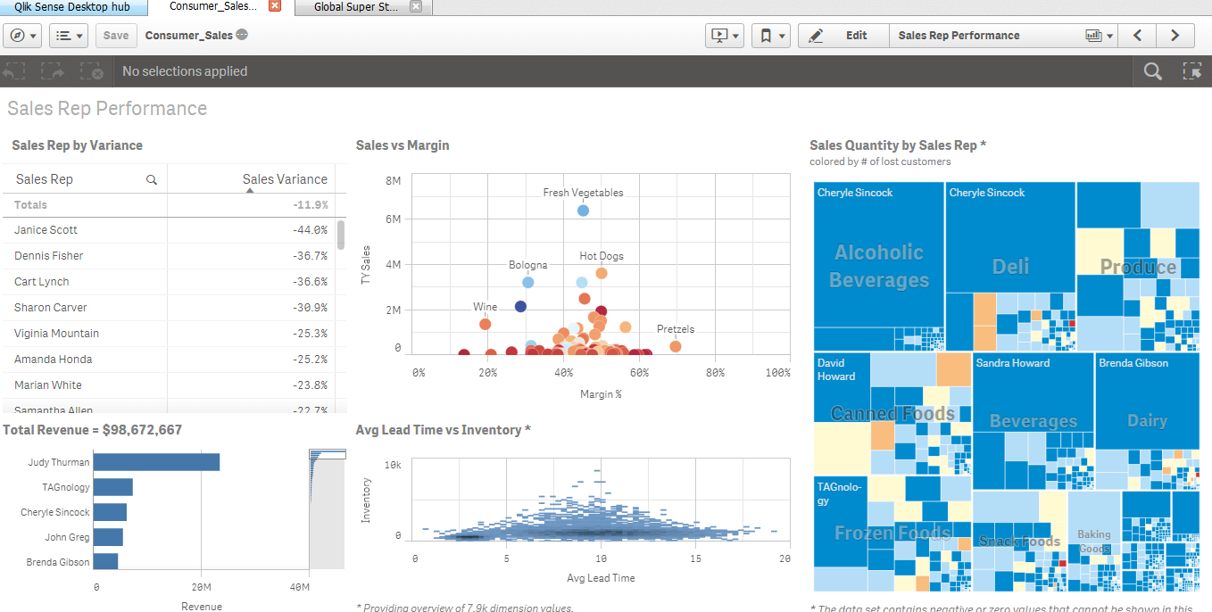
Reload Data For Analysis
Sheets provide a way of structuring your ideas and purposes for your app.
When you have understood the data, how it is organized, and how its parts relate to each other, you should consider using well-known design patterns to communicate your data.
Visualizations are used to present the data that is loaded into the app. The selections you make in the app are reflected in all associated visualizations on all sheets.

Slide 30
Qlik Data Market
Make smarter business decisions. The Qlik DataMarket helps you find, connect and manage data from external sources
You can add data from external sources with Qlik DataMarket. Qlik DataMarket offers an extensive collection of up-to-date and ready-to-use data from external sources accessible directly from within Qlik Sense. Qlik DataMarket provides current and historical weather and demographic data, currency exchange rates, as well as economic and societal data.
The major categories of Qlik DataMarket are:
Business: The most relevant data on firms and establishments, both locally and nationwide.
Demographics: Detailed population data for North America, Europe and the rest of the world.

Slide 31
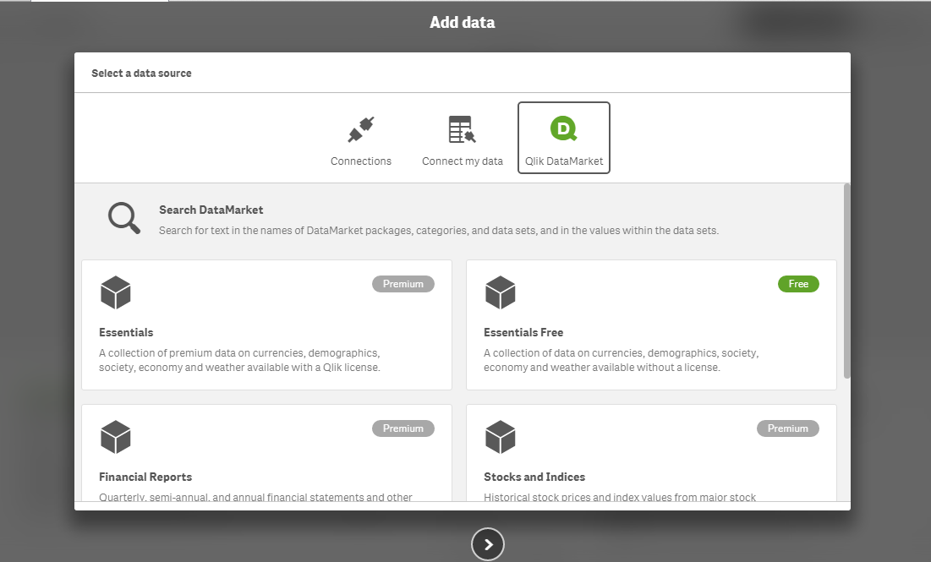
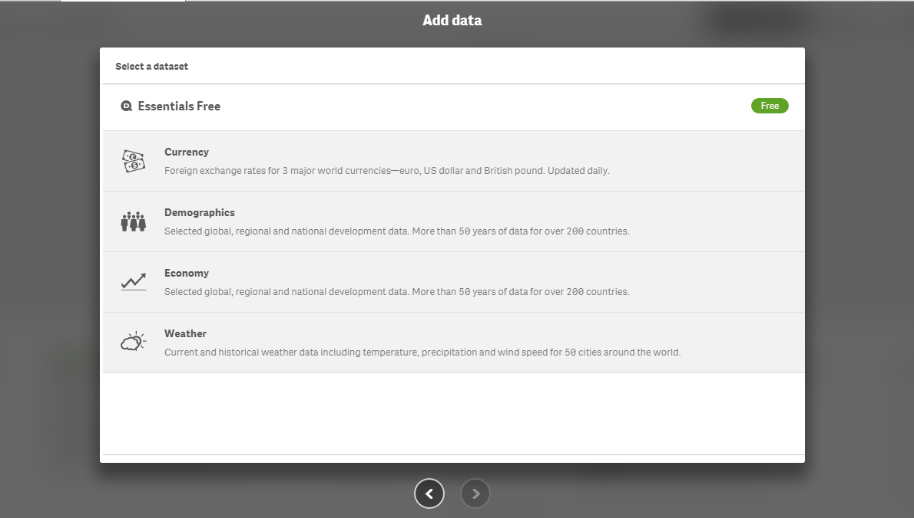
Qlik Data Market (Contd..)
Weather: Current and historical weather conditions for major locations around the world.
Currency: Foreign exchange rates for major world currencies, updated daily.
Society: Major socioeconomic data on wages, unemployment and poverty.
Economy: Major economic indicators featuring data on GDP, prices, education and environment.
Some Qlik DataMarket data is available for free. Data in the Essentials package is available for a subscription fee.

Slide 32
Thank You

